Slide 1
Web Designs & Languages
CSC1720 – Introduction to Internet
Essential Materials

Slide 2
Outline
WWW and Internet
Web Server and Web Clients
How does the WWW work?
Who defines the Web standards?
Web Programming Languages
  Markup Languages
    HTML, WML, XML, XHTML
  Client-side & Server-side Scripting
    JavaScript, VBScript, Java Servlets, ASP, JSP

Slide 3
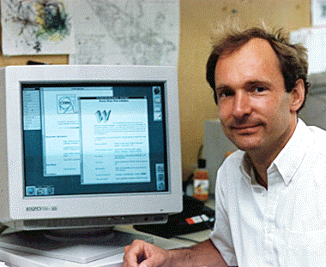
The World Wide Web
Affectionately called “The Web”
It is a collection of information stored on the networked computers over the world.
The WWW was proposed in 1991 by Tim Berners-Lee at CERN.

Slide 4
Web or Internet?
They are not the same things.
The Internet is a collection of computers or networking devices connected together.
  They have communication between each other.
  Decentralized design that there is no centralized body controls how the Internet functions.
The Web is a collection of documents that are interconnected by hyper-links.
  These documents are accessed by web browsers and provided by web servers.

Slide 5
Internet Terminology
Client
  Any computer on the network that requests services from another computer on the network.
Server
  Any computer that receives requests from client computers, processes and sends the output.
Web Page
  Any page that is hosted on the Internet.
Web Development
  The process of creating, modifying web pages.

Slide 6
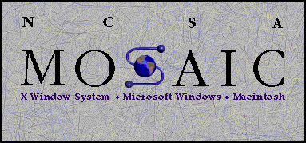
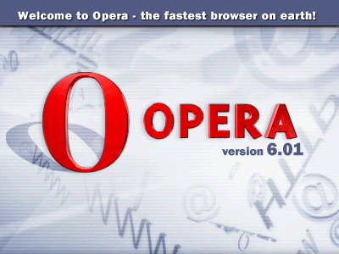
Web Browser (Web Client)
It is a program that retrieves information from the Web.
  Microsoft Internet Explorer
    Most commonly used browsers
  Netscape, Mosaic
    Many different computing platforms
  Opera
    The fastest browser on Earth
  Lynx
    Text based web client

Slide 7
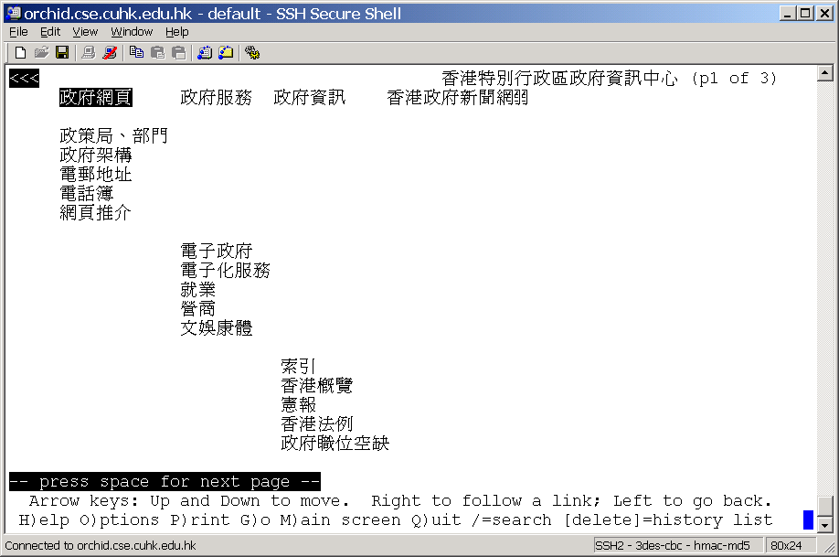
Lynx – UNIX based
Text mode browser, fast!

Slide 8

Some Statistics
Until July 02
  Internet Explorer 6.x 39%
  Internet Explorer 5.x 51%
  Internet Explorer 4.x 2%
  Netscape 3%
  Others 1%
  Win98/ME 64% , Win 95 4%
  WinNT 5% , Win2000 20%
  MAC 1% , www.thecounter.com

Slide 9
Internet Explorer
Version 1.0 - August 1995
Version 2.0 - November 1995
Version 3.0 - August 1996
Version 4.0 - October 1997
  Support CSS & DOM, but no XML
Version 5.0 - March 1999
Version 5.5 - July 2000
Version 6.0 - August 2001
  The latest version

Slide 10

Netscape Navigator
Netscape 1.0 - December 1994
Netscape 2.0 - March 1996
Netscape 3.0 - August 1996
Netscape 4.0
  The latest one is 4.79
Mozilla
Netscape 5.0 - Skipped
Netscape 6.0 - November 2000
Netscape 6.1 - August 2001
Netscape 6.2 - November 2001
Netscape 7.0

Slide 11

Web Server
It is a program that waits for requests from the web browser.
It provides four major functions
  Serving web pages
  Running gateway programs (CGI) and returning output
  Controlling access to the server
  Monitoring and logging all access
E.g. Apache, IIS, Netscape Web server, …

Slide 12
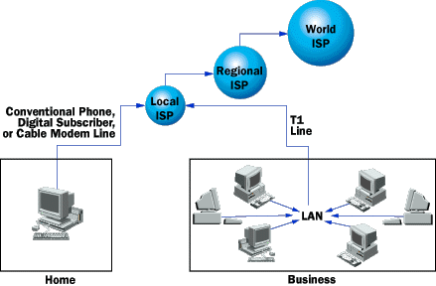
Web connection

Slide 13
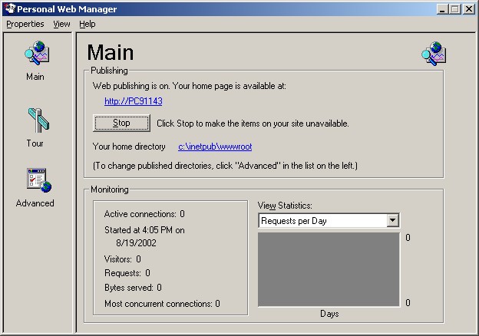
Web Server - Example
The URL
Where you place your web site

Slide 14
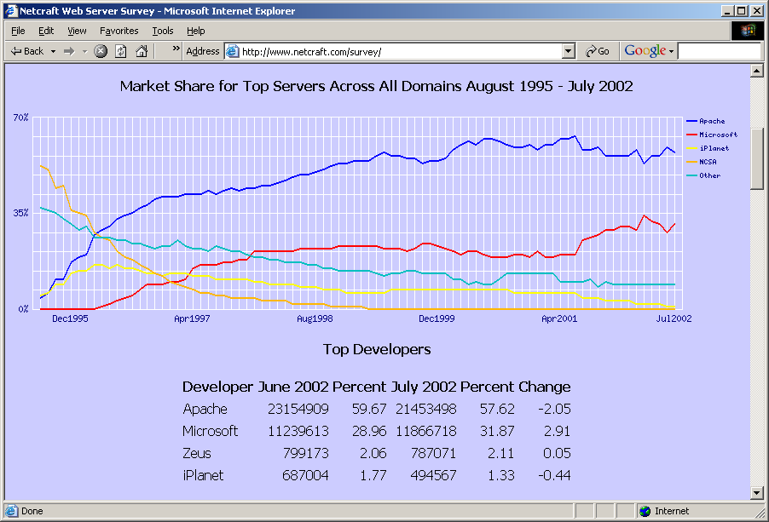
Web Server Statistics
Apache vs. MS
6 : 3

Slide 15
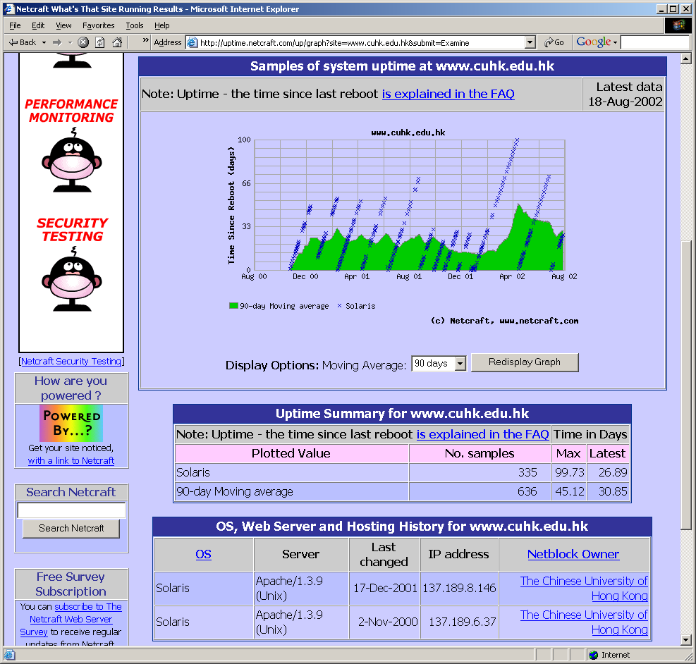
Which server is running?
Examine www.cuhk.edu.hk from netcraft

Slide 16
How does the Web work?
The web information is stored in the Web pages.
  In HTML format.
The web pages are stored in the computers called Web servers.
  In the Web server file system.
The computer reading the pages is called web clients with specific web browser.
  Most commonly Internet Explorer or Netscape.
The web server waits for the request from the web clients over the Internet.
  Internet Information Server (IIS) or Apache.

Slide 17


The HTTP Request/Response Model
HTML Codes
<html>
…
</html>
Request
Response
Client
Server
Program /
Scripts

Slide 18
Valid HTTP Request/Response mesgs
Provides additional information
GET /index.html HTTP/1.0
Host: www.anyhost.com
User-Agent : Mozilla/4.5 [en] (WinNT; I)
Accept : image/gif, image/jpeg, */*
Accept-language : en
Accept-charset : iso-8859-1, *, utf-8
HTTP/1.0 200 OK
Last-Modified: Mon, 20 Dec 1999 …
Date: Tue, 11 Jan 2002 …
Status: 200
Content-Type: text/html
Servlet-Engine: Tomcat Web Server
Content-Length: 59
<html>
…
</html>

Slide 19
HTTP
HTTP (Hypertext Transfer Protocol)
  protocol used to access data on the WWW.
  uses one TCP connection on well-known port 80.
  two types of http messages: Request, Response
  transfer data in the form of plain text, hypertext, audio, video, and so on.

Slide 20
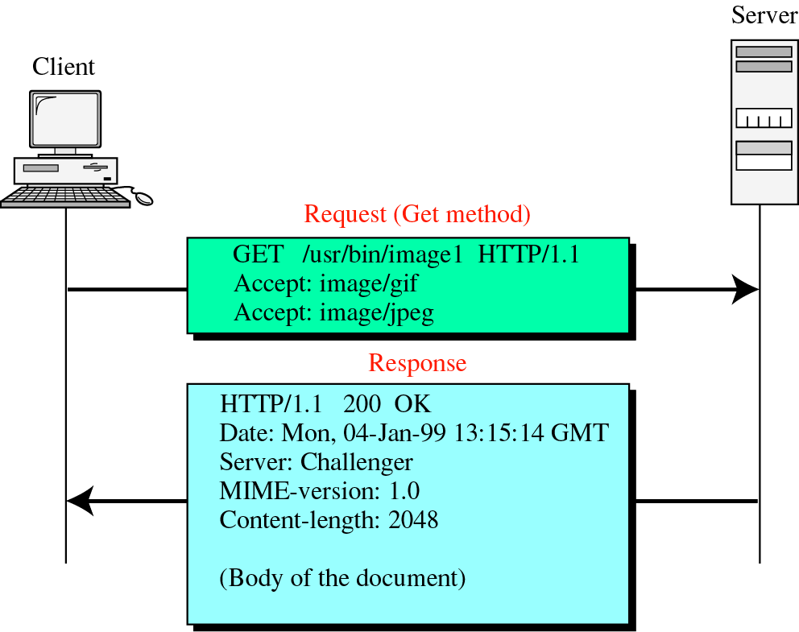
HTTP
DEMO!

Slide 21
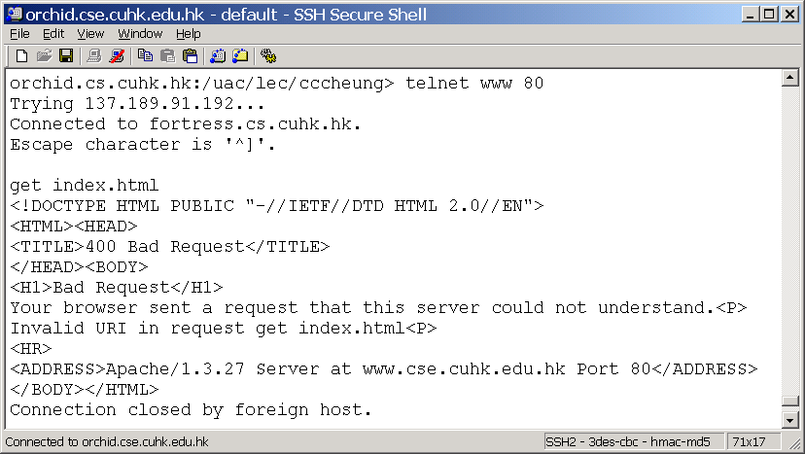
Example – Request/Response

Slide 22
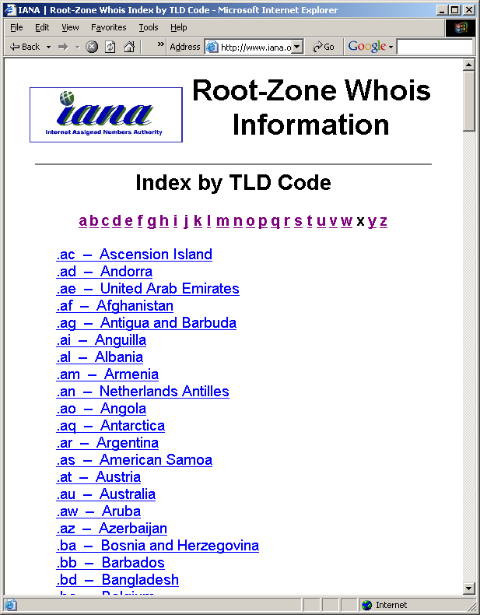
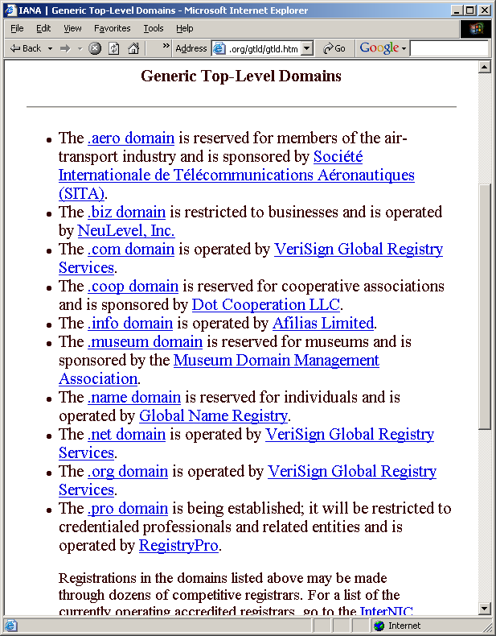
Top-Level Domains
Generic
domain
Country code
domain

Slide 23
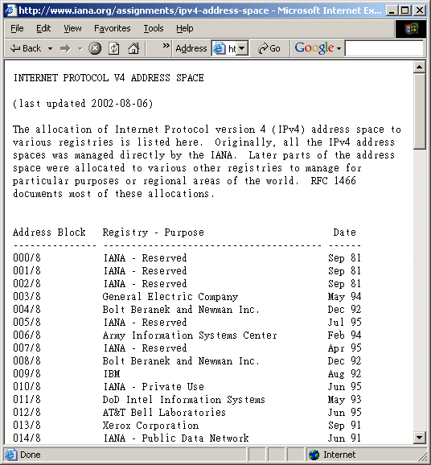
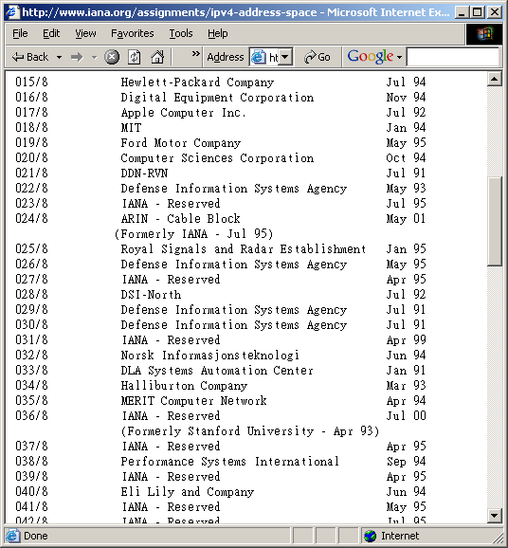
IP Address Space

Slide 24

Who defines the Web standards?
The Web standards are not defined or setup by the browser companies or Microsoft, but the World Wide Web Consortium (W3C).
The specifications form the Web standards.
  HTML, CSS, XML, XHTML, …

Slide 25

W3C
Quoted from W3C
  W3C's long term goals for the Web are:
  Universal Access: To make the Web accessible to all by promoting technologies that take into account the vast differences in culture, languages, education, ability, material resources, and physical limitations of users on all continents;
  Semantic Web : To develop a software environment that permits each user to make the best use of the resources available on the Web;
  Web of Trust : To guide the Web's development with careful consideration for the novel legal, commercial, and social issues raised by this technology.

Slide 26
Web Programming Languages
The Web is no longer just presenting information on a computer screen.
  Many commercial sites include some methods of getting information from a browser to web servers.
    How do you program your web site such that it can interact with people?
  With XML, data from spreadsheets, reports or other applications can be easily displayed on the Web.
    Can we learn XML without the understanding of HTML and other Web language?

Slide 27
The History of Markup
In the early 1970s
  GML (the Generalized Markup Language)
  “:h1.The Content is placed here”
Since the 1980s
  SGML (the Standard GML)
  HTML
Currently
  XML
    Not intended to replace HTML!
    XHTML does by providing better data description, …

Slide 28
SGML, HTML and XML
simplifies
Meta
Language
SGML
XML
defines
Language
HTML
XHTML
XML
Definitions
Meta
Data
Usage of the
Language
Web pages
XML
Documents
Data

Slide 29
HTML
HyperText Markup Language
It is not a programming language.
  Cannot be used to describe computations.
  Use to describe the general form and layout of documents to be displayed by the browser.
Compose of “Content” and “Controls”

Slide 30
HTML Element / Tag
<p align=“right”> </p>
Element
Attribute Name
Attribute Value
You have to understand the important terms related to HTML.
Not case-sensitive.

Slide 31
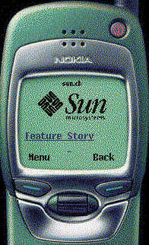
WML
Wireless Markup Language
  Formerly called HDML (Handheld Devices Markup Languages)
  Allows the text portions of web pages to be displayed on cell phones or PDAs via wireless media.
  It is part of the Wireless Application Protocol (WAP).

Slide 32
XML
eXtensible Markup Language (XML)
It provides a standard way to represent information so as to allow information to be stored and interchanged among any Internet-connected devices.
  It is not a markup language.
  It is a meta-markup language that specifies rules for creating markup languages.
  Browsers use XML parsers to isolate and extract the information from XML documents.

Slide 33
Examples of XML-based languages
Acronym | Name | Description
CDF | Channel Definition Format | One of the first real-world applications of XML, permits automatic delivery of updated web information (Microsoft)
CML | Chemical Markup Language | Conversion of current files into structured documents (chemical publications)
ETD-ML | Electronic Thesis & Dissertation ML | Converts theses from MS-Word into XML
FlowML |  | A format for storing audio synthesis diagrams for synthesizers
ITML | Information Technology ML | A set of specifications for protocols, message formats
MathML | Mathematical ML | Describes mathematical notations
VXML | Voice XML | Allows interaction with the Internet thru voice-recognition technology
XHTML | Extensible HTML | HTML 4.0.1 is written as an XML application
XSL | Extensible Stylesheet Language | The style standard for XML, specifies the presentation and appearance of an XML document
XSLT | XSL Transformation Language | Uses to transform XML documents into another XML files

Slide 34




XML Transformation
Same XML Document
HTML
WML
XSL
Transformation
StyleSheet 1 (XSL)
StyleSheet 2 (XSL)
XML Document

Slide 35
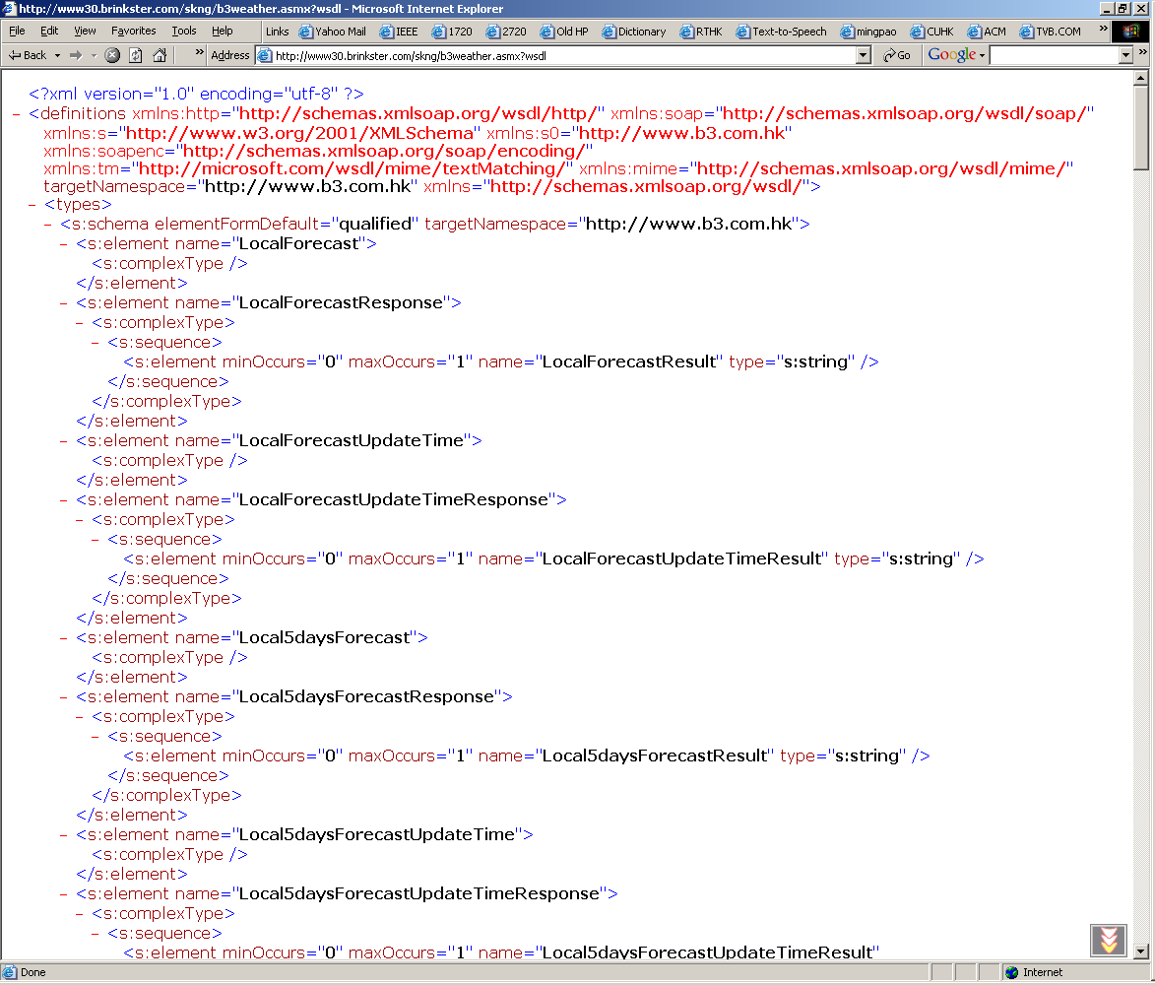
XML Example
Reference:
  HK Weather Forecast

Slide 36
MathML Example
E = mc²
MathML Presentation Markup Example
<mrow>
<mi>E</mi><mo>=</mo><mi>m</mi>
<msup>
<mi>c</mi>
<mn>2</mn>
</msup>
</mrow>

Slide 37
XHTML
The eXtensible HyperText Markup Language
  A Reformulation of HTML 4 in XML 1.0
  Consists all HTML 4.0.1 predefined components combined with XML standards
A way of making XML documents that look and act like HTML documents.
Using XHTML helps you strengthen the structure and syntax of your markup.

Slide 38
HTML – OK, XHTML - !OK
<HTML>
<HEAD>
<TITLE>My Title</TITLE>
<body></HEAD>
<td>It is an acceptable HTML, but an unacceptable XHTML
</BODY>
…
<table WIDTH=80%> ← Incorrect
<table width=“80%”> ← Correct
Test

Slide 39
Evolution of the XHTML family
SGML (1986)
HTML 2.0 – 4.0.1
(1990 – 1999)
XML
Others
XHTML Basic
(Dec 19, 2000)
Modularization
of XHTML
XHTML 1.0
(Jan 26, 2000)
Others
XHTML 1.1
(May 31, 2001)

Slide 40
Cascading Style Sheets (CSS)
Provides a powerful and flexible way to control the details of web documents.
HTML is more concerned about the content, CSS is used to impose a particular style on the document.
Named cascading style sheets because they can be defined at three different levels to specify the style of a document.
  Inline, document level, external.

Slide 41
Using Stylesheets to add presentation
HTML Page
Web browser
Displayed page
CSS stylesheet

Slide 42
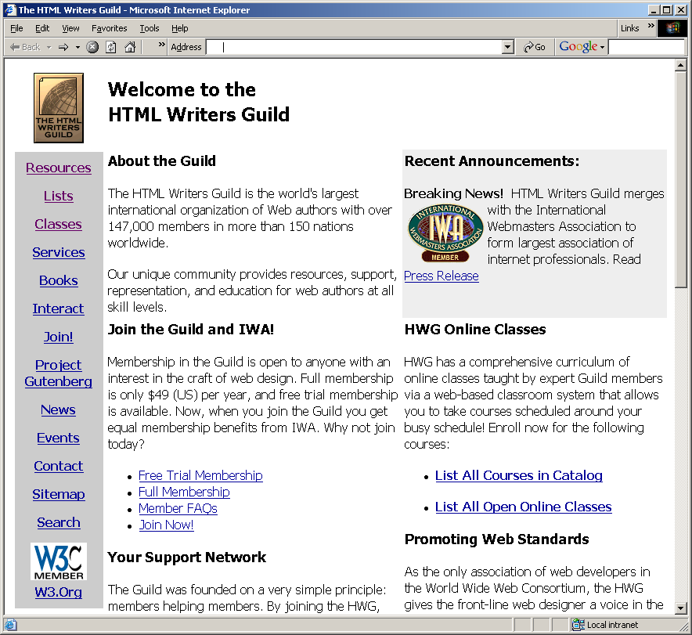
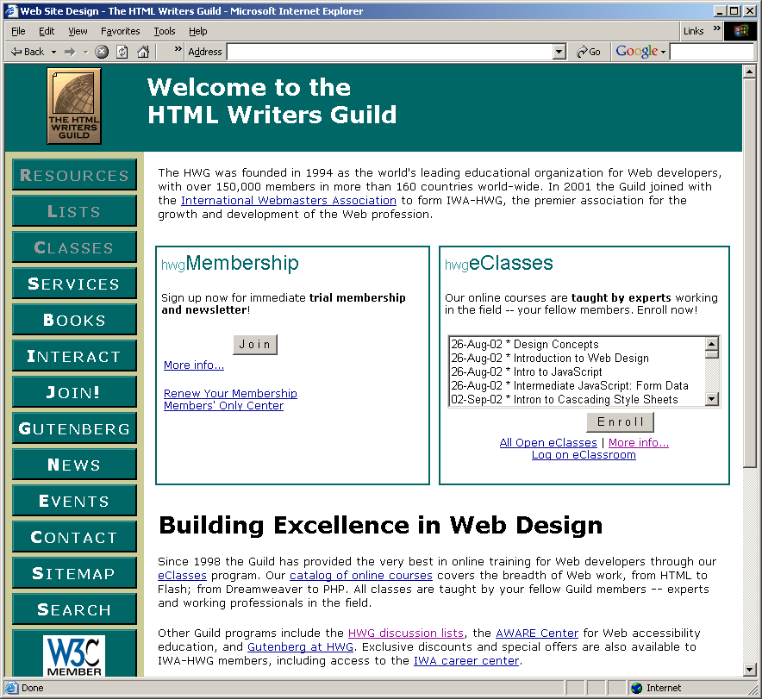
CSS Example

Slide 43
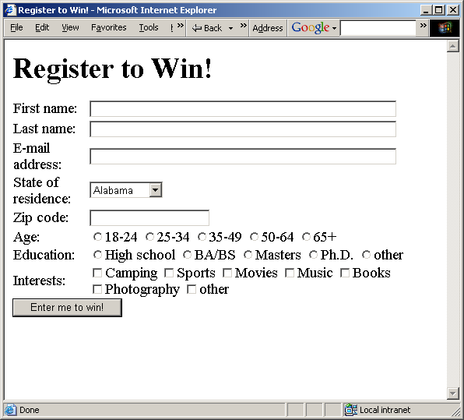
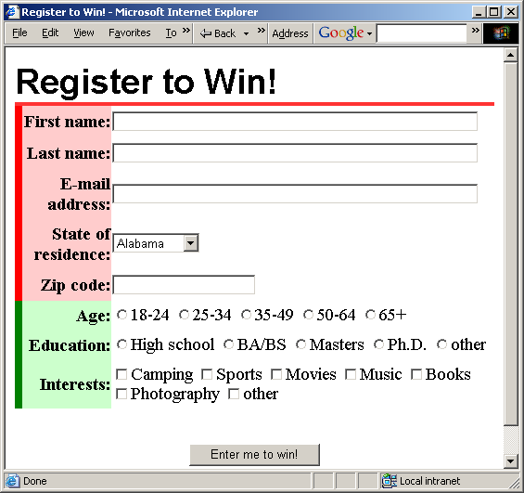
CSS Example:
Skin an Input Form?

Slide 44
Client-Side and Server-side Programming
Client-side code
  ECMAScript
    JavaScript, JScript – Microsoft
  VBScript – Microsoft
  Embedded in <script> elements and execute in the browser, provides immediate feedback to the user.
  Reduces the load on a server, reduces network traffic.
Server-side code
  Execute on the server
  CGI/Perl, ASP, PHP, ColdFusion, JSP
  The code remains hidden from users, and browser independent.
Can be combined with good results.

Slide 45
Client-side & Server-side
Technologies
Client-Side | Server-Side
HTML, XML Cascading Style Sheets (CSS) Scripting languages - JavaScript, VBScript Java Applets ActiveX controls Plug-ins and Helpers application | CGI/Perl PHP ColdFusion Scripting Languages - Server-side JavaScript - ASP, JSP, Java Servlets ISAPI/NSAPI programs

Slide 46
JavaScript
There is no relationship between Java and JavaScript – misleading!
It provides a computational capability in web documents.
It is used in creating, accessing, modifying a document.

Slide 47
What can JavaScript do?
Control document appearance and content
Control the browser
Interact with the user
Read and Write Client State with Cookies
  my.yahoo.com
Interact with Applets
What it cannot do?
  Read/write files

Slide 48
DHTML
It is used to describe a set of animated web documents that built from HTML, style sheets and scripts.
There are three main parts of DHTML
  Positioning
  Style modifications
  Event handing
It relies on the browser for the display and manipulation of the web pages.

Slide 49
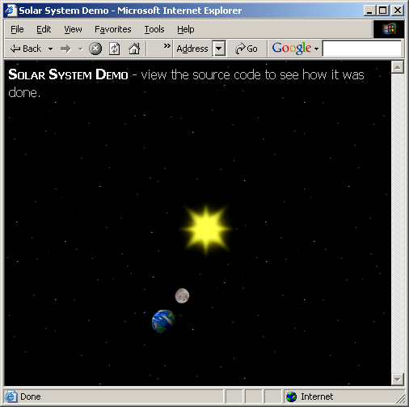
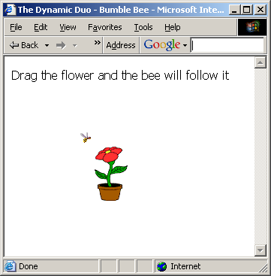
DHTML Examples
Reference: Dynamic Duo

Slide 50
VRML
Virtual Reality Modeling Language (VRML) is a language for the animation and 3D modeling on the Internet.
The user can connect the online VRML website and move around the “3D world”.

Slide 51
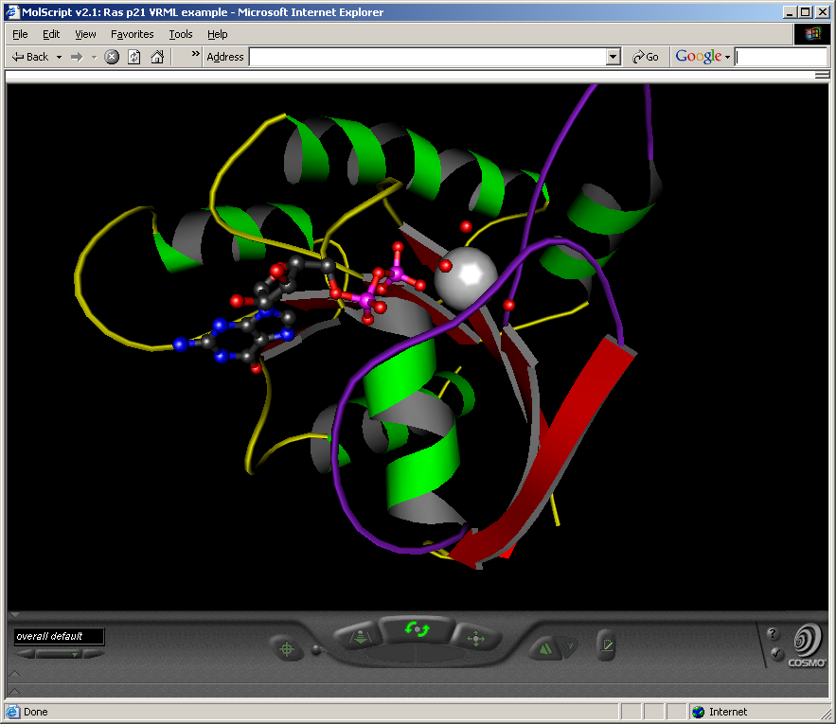
VRML Example
Reference:
  MolScript

Slide 52

Break Time – 10 minutes

Slide 53
CGI / Perl
When the page is loaded by a browser, the tag of the webpage call the script and then execute by the server.
It is different from the Java applets or JavaScript which are executed by the client’s system.

Slide 54
CGI / Perl
Common Gateway Interface (CGI) is a standard way in which a browser communicate to run a program on the server and return the output to the browser.
  It can be written in any programming language (most common is Perl).
  It is a powerful string pattern-matching language.

Slide 55
Using Scripts
Database
scripts
File stored
HTML Page
Web browser
Displayed page
CSS stylesheet

Slide 56
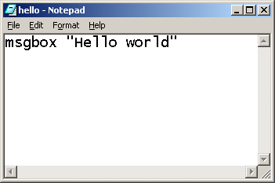
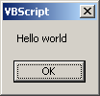
VBScript
VBScript is the short form for Visual Basic Scripting from Microsoft.
Try to edit a file “hello.vbs”
  Msgbox “Hello world”

Slide 57


ASP
Active Server Page was developed by Microsoft and it is a popular technology for developing dynamic web sites.
  It allows the author includes scripting code (VBScript or JScript) in regular web pages.
  In complex code, COM (ActiveX) components are used.
  Must run on an active server pages server
    IIS, Personal Web Server, …
  The latest version is ASP.NET

Slide 58
How to load an ASP page?
Request
Hands request to
ASP
Server
Component
Reply with
HTML page
Client
Server
Hands HTML page
Translates
Script
Into
HTML

Slide 59

PHP
It is not an acronym for anything.
  An open source web scripting language.
  A PHP page is always interpreted by the server when it is requested.
  The latest version is PHP 4.
  Have to learn an entirely new language.
  Reference: http://www.php.net/

Slide 60
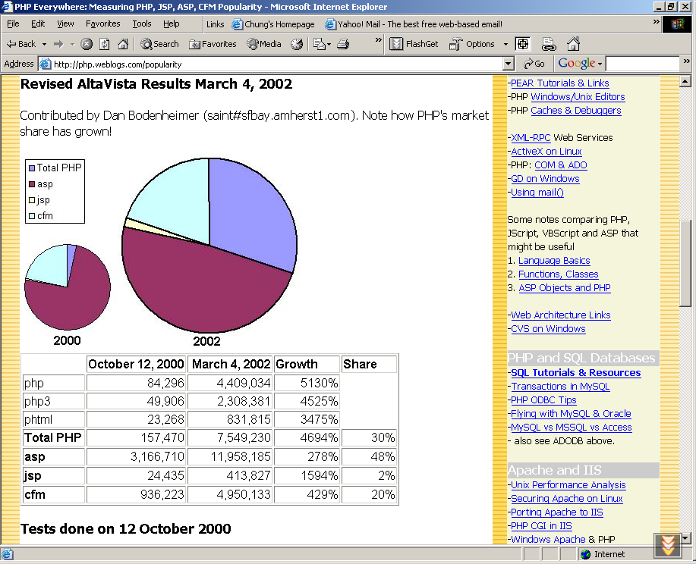
PHP Popularity
http://php.weblogs.com/popularity

Slide 61
ColdFusion
It is a Web application development environment produced by the Macromedia Corporation.
CF Page
Request *.cfm
Cold Fusion
Application
Server
Reply Web Page
Client
Web Server
Web Page

Slide 62
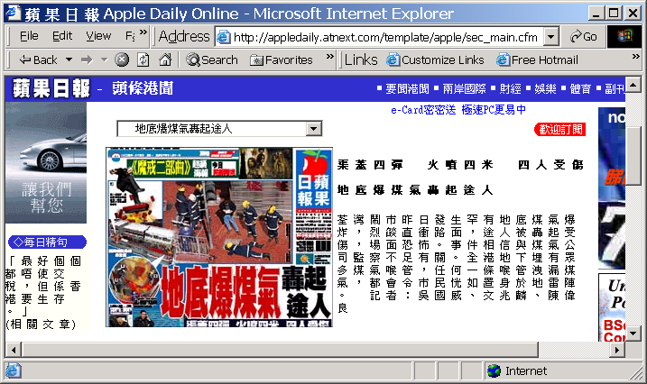
ColdFusion Example
*.cfm

Slide 63

JAVA / Java applet
It is used to solve the problem that HTML is not a programming language.
  Instead of running a program on the web server, a special kind of Java program (applet) is downloaded to the browser.
  JavaScript is less powerful than Java.
  JavaScript code is physically part of an HTML document, but applets are stored separately from the HTML files.

Slide 64
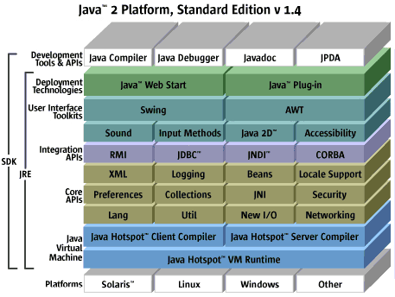
Java 2, Standard Edition
Source:
java.sun.com

Slide 65
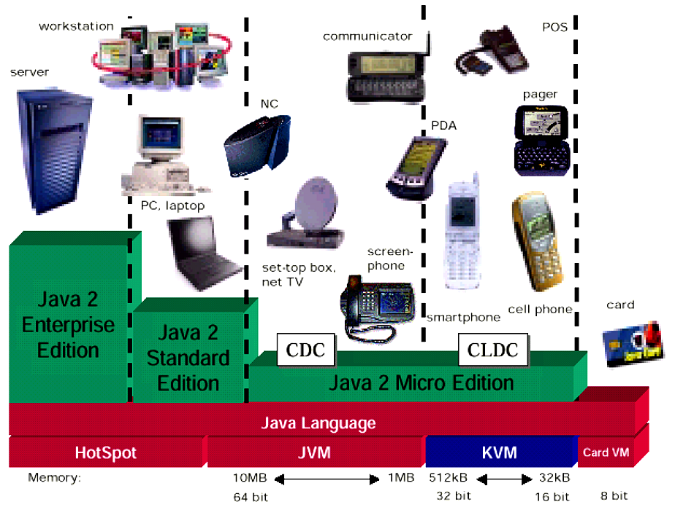
Java 2 Platforms

Slide 66
What are Java Servlets?
An extremely popular Java substitute for CGI scripts.
They are programs to be run on a web server.
The web page is based on the data submitted by the user.
More efficient, easier to use, Powerful and Portable.

Slide 67

Java Servlets
They are Java application programs that are resident on the server and are alternatives to CGI programs.
Java Servlets allow you to build
  Web page based on the user’s input data
  Web page that changes frequently
More efficient, easier to use, more powerful and portable.

Slide 68
Servlets Advantages
Platform and vendor independence
  Supported by all the major web servers
Integration
  Take advantages of all the Java technologies, JDBC, Enterprise JavaBeans (EJB).
Efficiency
  A single process that runs until the servlet-based application is shut down.
Scalability – extremely scalable.
Robustness and security
  A strongly typed programming language.

Slide 69
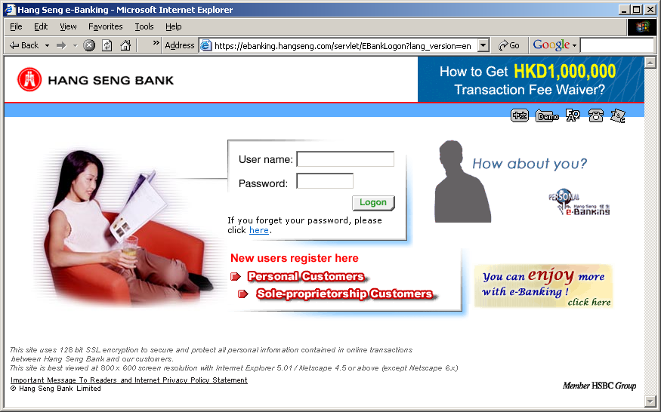
Servlet Example

Slide 70

What is JSP?
It is JavaServer Pages that built on top of Java servlets in late 1999.
In the early days of the Web, the only tool for developing dynamic web content was CGI. For every request, the web server creates a process (not efficient).
The Java Servlet API has introduced in 1997, however, HTML code has to be embedded inside programs. (lot of “out.println()”)
JSP provides a development model for the web authors to experience all the server-side technologies.

Slide 71
JSP page translation and processing phases
Translation phase
Hello.jsp
Read
Request
helloServlet.java
Generate
Response
Client
Server
helloServlet.class
Execute
Processing phase

Slide 72
A simple example
Java Servlet & JSP
import java.io.*;
import javax.servlet.*;
import javax.servlet.http.*;
public class HelloWorld extends HttpServlet {
public void doGet(HttpServletRequest req, HttpServletResponse res)
throws ServletException, IOException {
res.setContentType("text/html");
PrintWriter out = res.getWriter();
out.println("<HTML>");
out.println("<HEAD><TITLE>Hello World</TITLE></HEAD>");
out.println("<BODY>");
out.println("<BIG>Hello World</BIG>");
out.println("</BODY></HTML>");
}
}
<HTML>
<HEAD>
<TITLE>Hello</TITLE>
</HEAD>
<BODY>
<H1>
<%
if (request.getParameter("name") == null)
{
out.println("Hello World");
} else {
out.println("Hello, " + request.getParameter("name"));
}
%>
</H1>
</BODY>
</HTML>

Slide 73
Template Pages
Server Page Template
<html>
<title>
A simple example
</title>
<body color=“#FFFFFF”>
The time now is
<%= new java.util.Date() %>
</body>
</html>
Resulting HTML
<html>
<title>
A simple example
</title>
<body color=“#FFFFFF”>
The time now is
Tue Nov 5 16:15:11 PST 2002
</body>
</html>
translation

Slide 74

What you need to get started?
A Personal Computer with an Internet connection, that allows you to download the software you need.
A Java 2-compatible Java Software Development Kit (Java 2 SDK)
A JSP 1.1-enabled web server, such as Apache Tomcat

Slide 75
JSP vs. ASP
 | ASP Technology | JSP Technology
Web Server | IIS or Personal Web Server | Any Web Server
Platforms | Microsoft Windows | Most popular platforms
Reusable components | No | JavaBeans, JSP tags
Security against System crashes | No | Yes
Scripting Language | VBScript, Jscript | Java
JSP is platform and server independent.
ASP relies on Microsoft Platforms and Servers.

Slide 76


ASP & JSP
<html>
<head><title>Hello World by ASP</title></head>
<body>
<font size=12>
<%
response.write “Hello INE2720 Students and the World!"
%>
</font>
</body>
<html>
<head><title>Hello World by JSP</title></head>
<body>
<font size=12>
<%
out.println("Hello INE2720 Students and the World!");
%>
</font>
</body>

Slide 77
Web Services
What are Web services?
  They are a distributed computing architecture.
Who is using Web services now?
  Industry technologies
Which approach should we use - .NET or J2EE?
Requestor, Registry, Provider

Slide 78
Critical Elements of a Basic Web Services Architecture
XML (Format)
Format
For presenting data and information
UDDI (Publish)
WSDL (Find)
SOAP (Bind)
Services
A directory service
A protocol for applications to find a service
A protocol that enables applications to agree the communication
Network
The Internet
The Internet, using TCP/IP protocols…

Slide 79
Service-Oriented Architecture
Find - UDDI
Requestor
Registry
Bind –
WSDL, SOAP
Publish - UDDI
Provider

Slide 80

References
Internet and World Wide Web How to Program – Deitel, Deitel and Nieto
The End.
Thank you for your patience!

